Slide 1

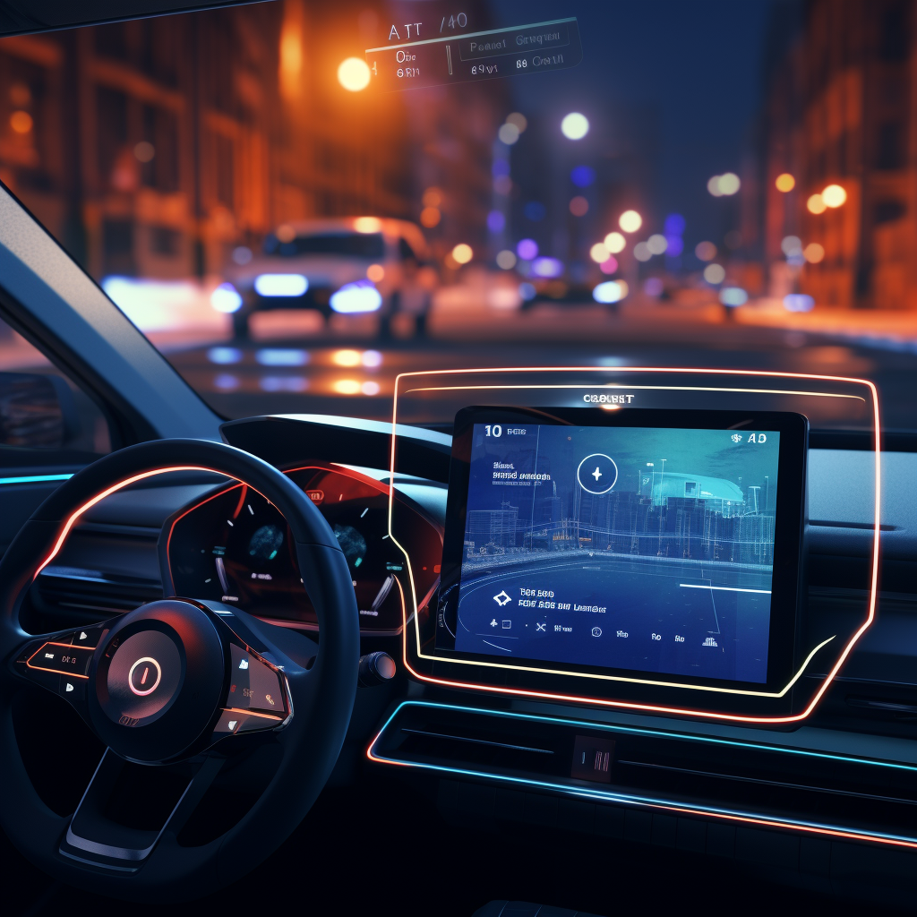
Enable Blind LLMs with Vision
---My Summer Research Summary
王杰，04/06/2024
Advisor: 向为教授 Prof. Wei Xiang
Mentor: 黄莹莹 Yingying Huang
Github: Summer_Research_2023
Notes:
我们为什么做这个工作，我们做这个工作有什么价值，架构逻辑要更清楚

Slide 2

Content
Project Intuition
Model Selection
Pipeline
Evaluation
Failure try
Ongoing process
Random Thought

Slide 3
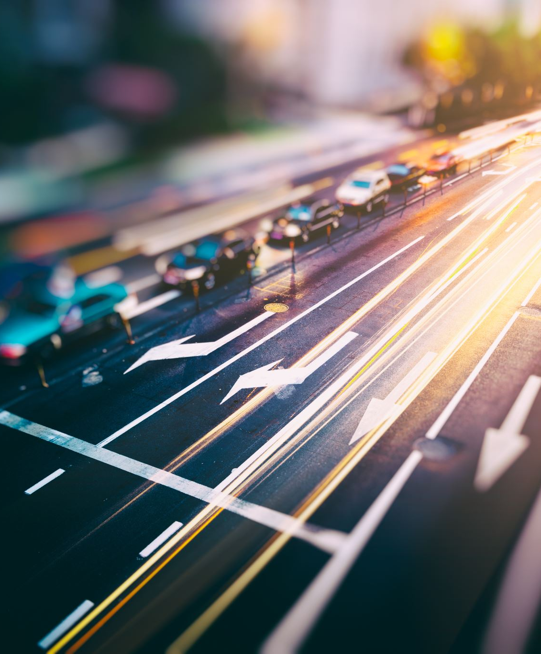
Intuition: Corner cases are countless, but LLM has logic
Road scene understanding is a relative complex and important topic in autonomous driving field.
Traditional approach like driving risk field or object detection is useful and practical, but they can’t cover all the possibilities in the real-world scenario (Too much annoying if-statements).
Solving it in a brand-new way is my intuitive study interest, because I saw the potential capability within LLM to be a co-pilot, helping drivers to recognize and avoid those potential risk.

Slide 4
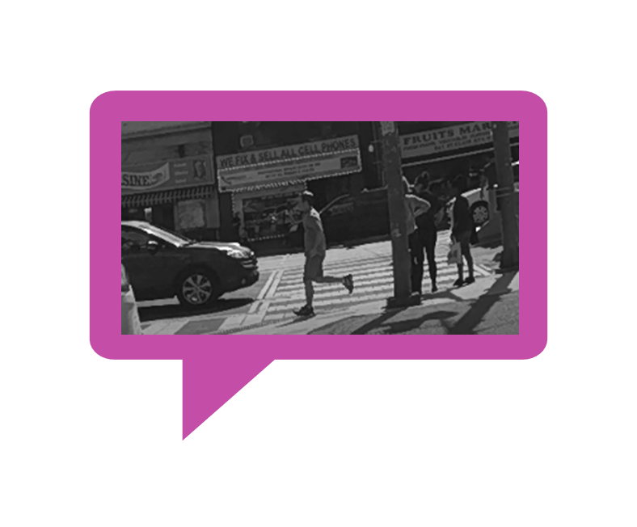

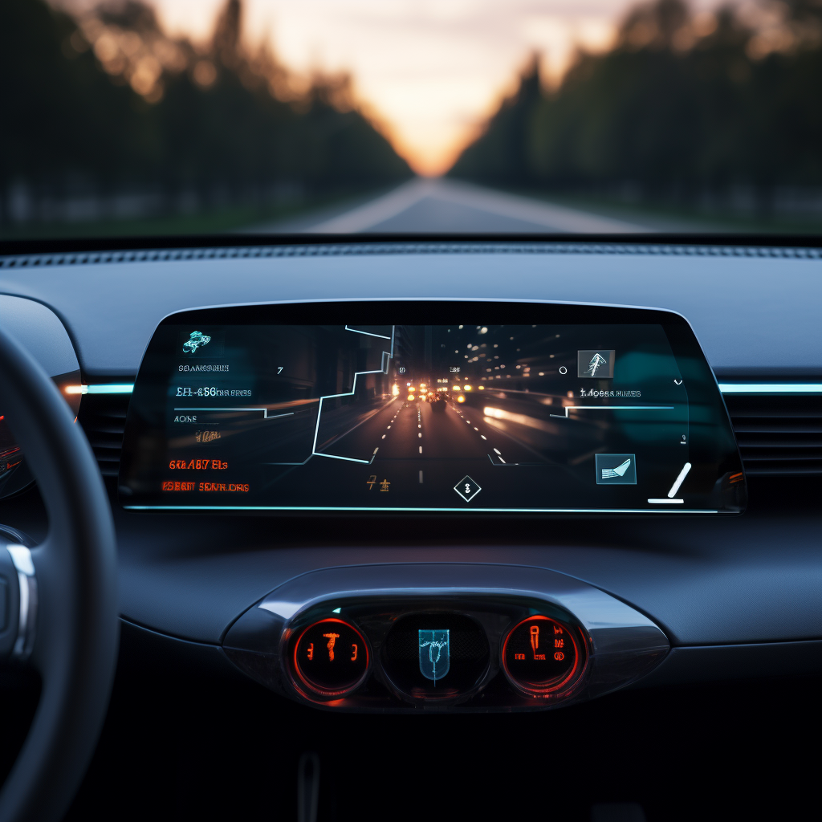
However, there is a huge gap between logic and reality: modality difference
“有啥子在我前头啊？看不着啊”
The ChatGPT can 'think 'through text conversation, but it doesn’t have internal capability of perception.
Therefore, we need to provide a tool for it to "read" the road (Road Scene Understanding).

Slide 5
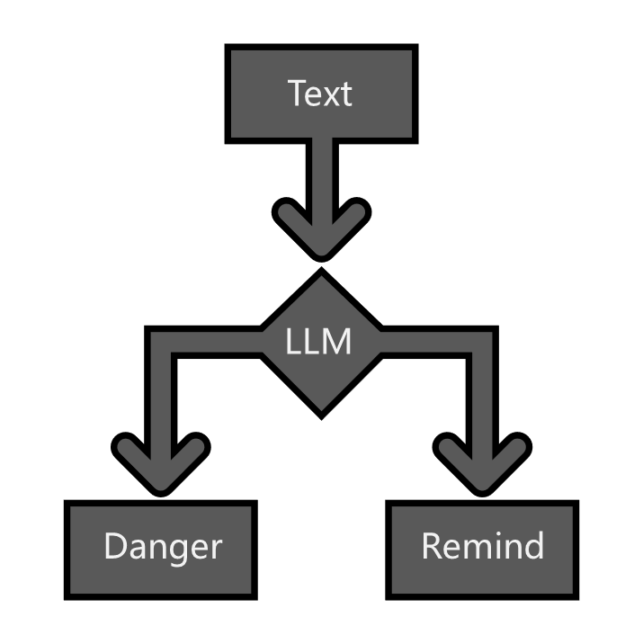
Our solution: combine SOTA models together, obtain on-road information
A vision2text cascaded connected model, helping the LLM to detect the road

Slide 6
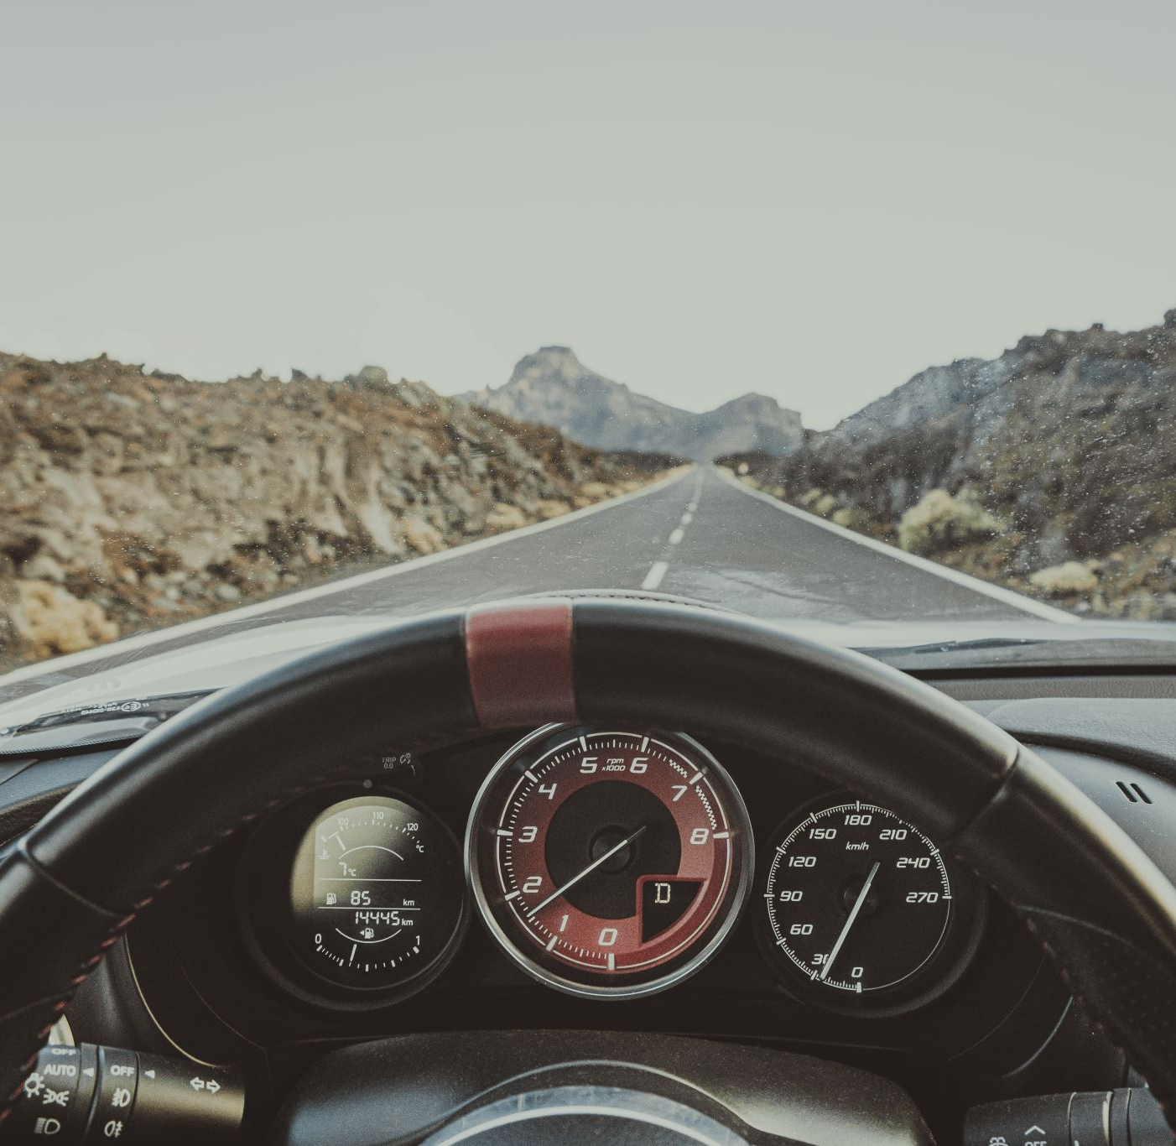
What is vision?
Video + Audio
- Because we focus on driving in-car scenario, we skip audio part
Video == a sequence of frame
So, we need to firstly know what happens within a frame

Slide 7
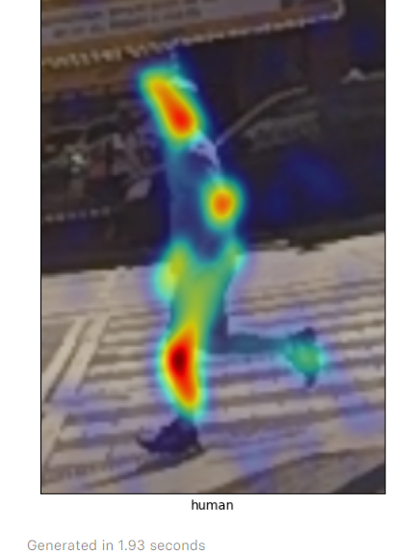
What is the Vision Feature of a pedestrian?
Location: road or sidewalk? Left or right side?
Distance: near or far from us?
Speed: fast or slow?
Type: old or young?

Slide 8
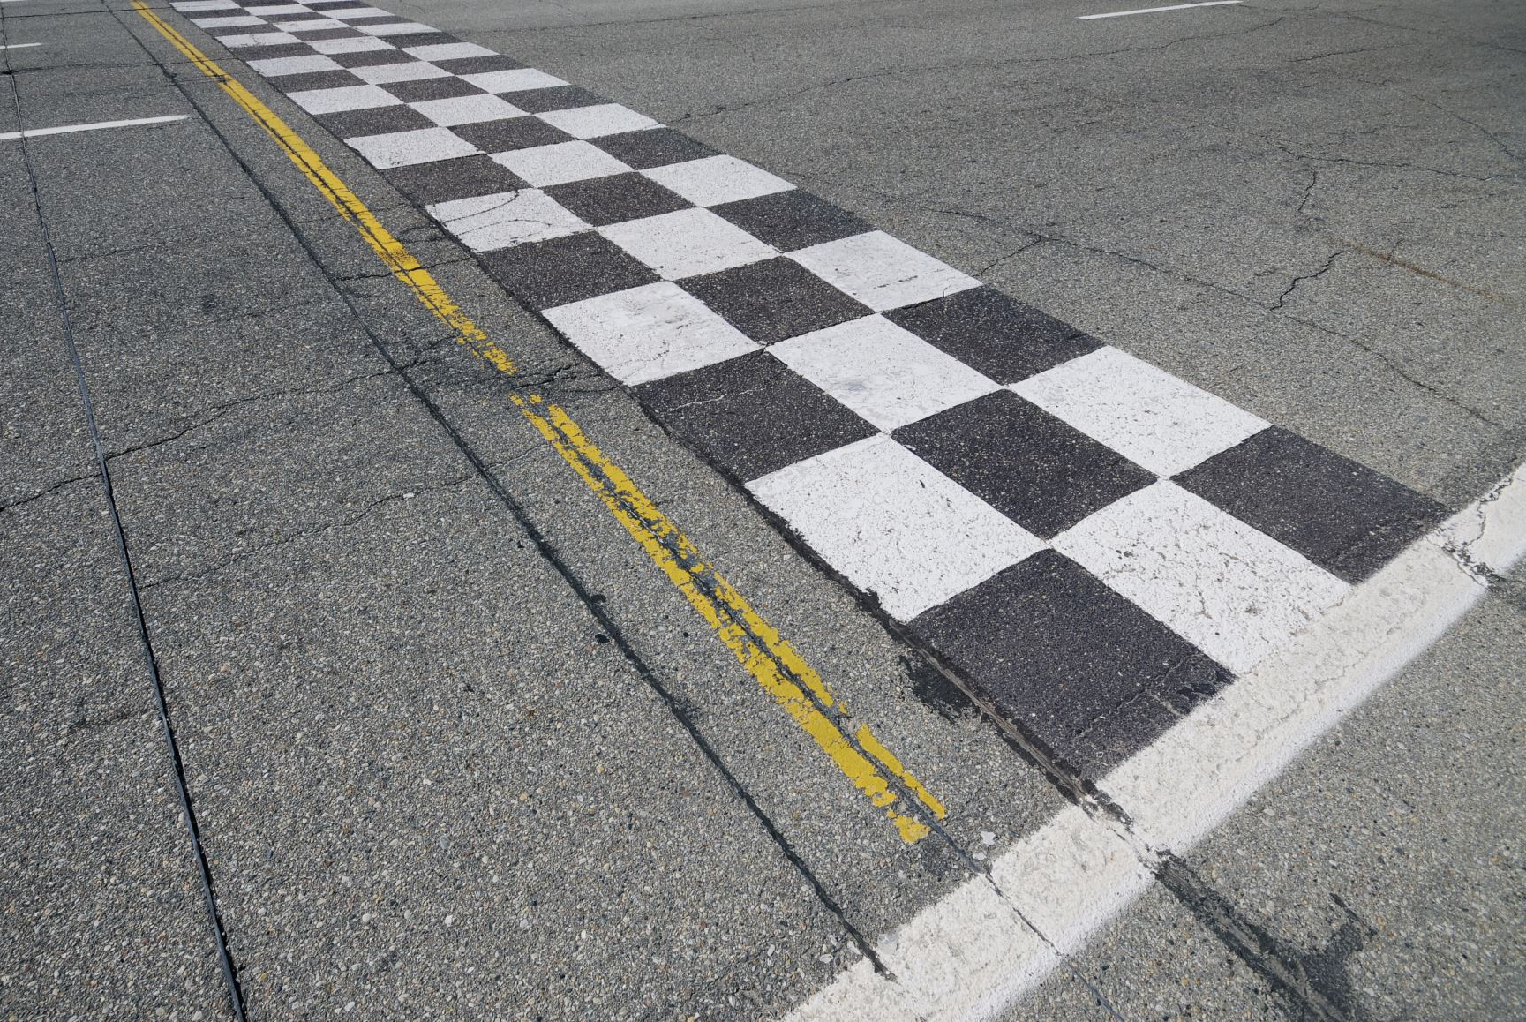
How to obtain the road / sidewalk information? Our answer: sam (not uncle)

Slide 9
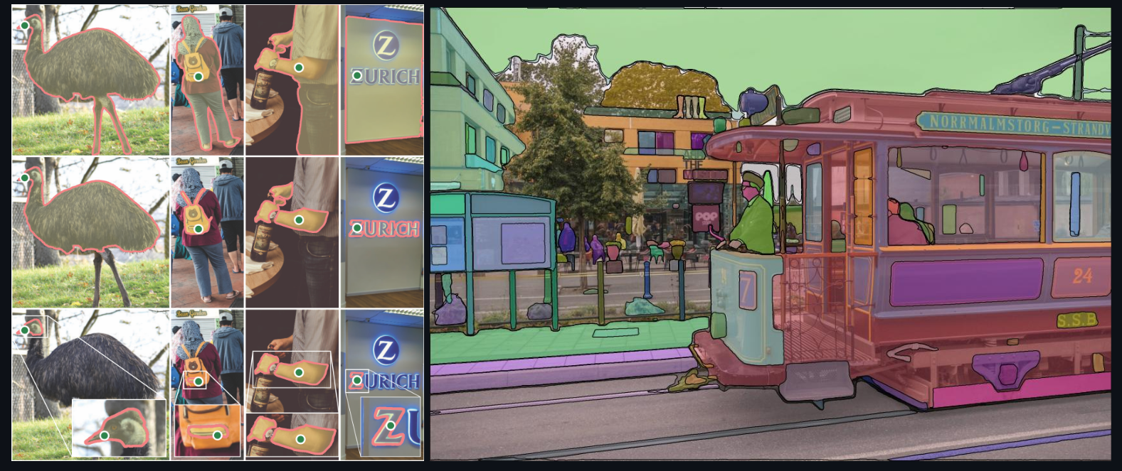
Segmentation: Segment Anything(SAM)
- [2023SOTA]
- Transformer based unlabeled segmentation, SOTA zero-shot segmentation

Slide 10
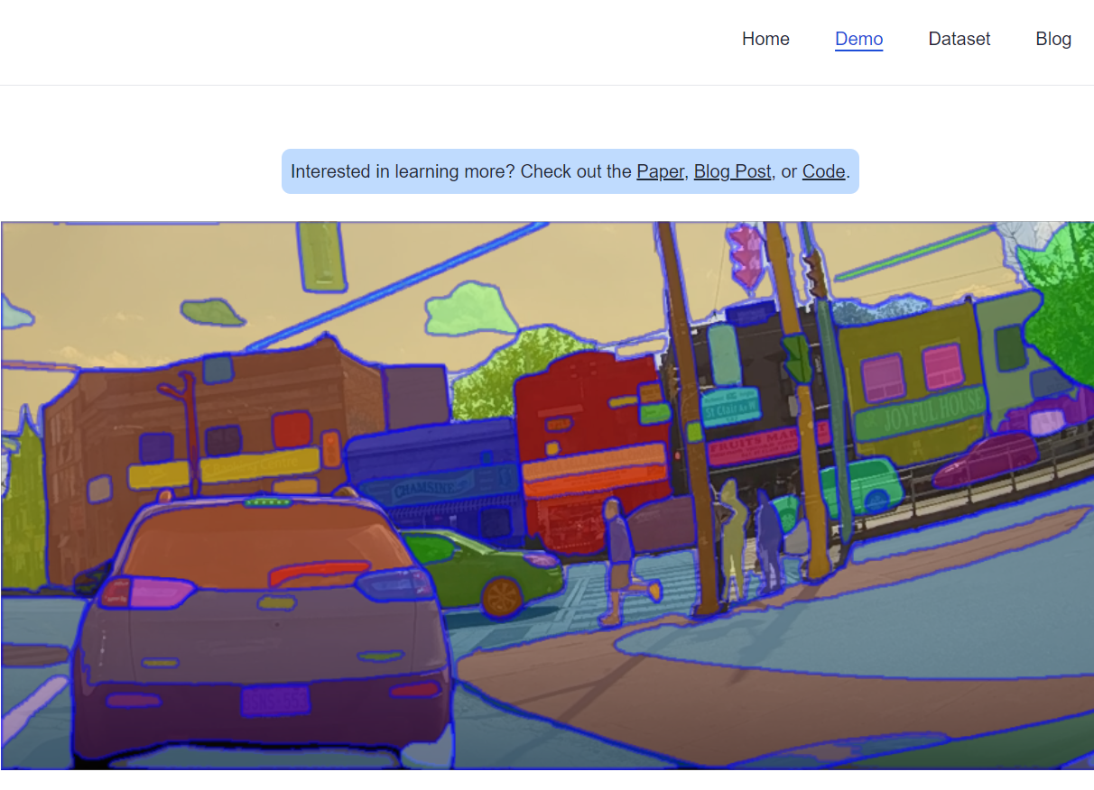
Divide the sidewalk from road
After segment everything, it’s clear that all the sidewalks are shown in the image.

Slide 11
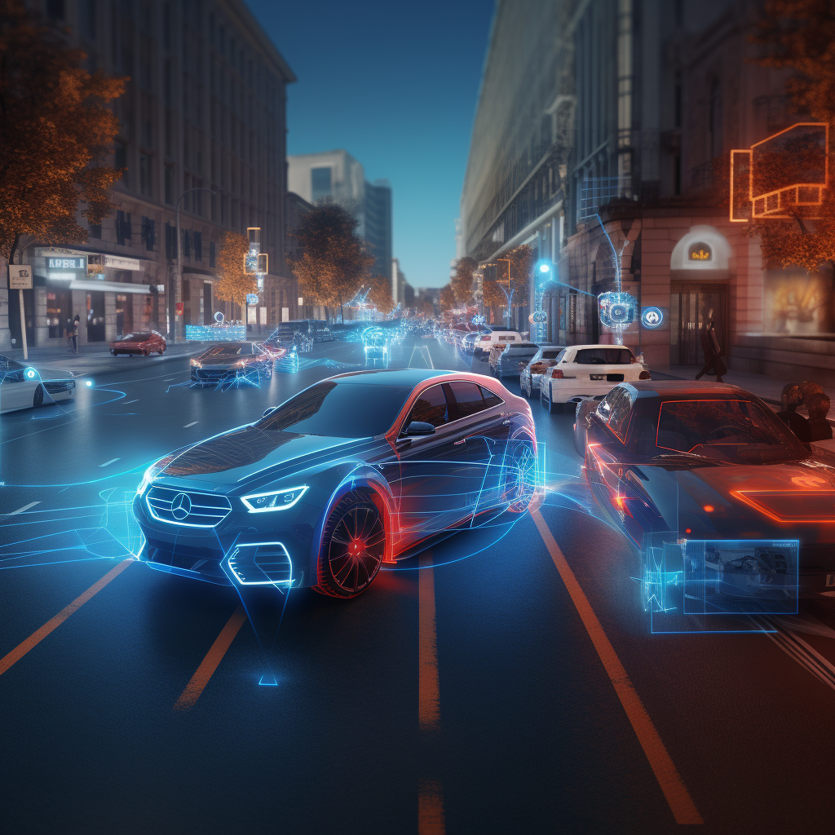
But segment everything is expensive!
How can we obtain the mask information easily from SAM?

Slide 12
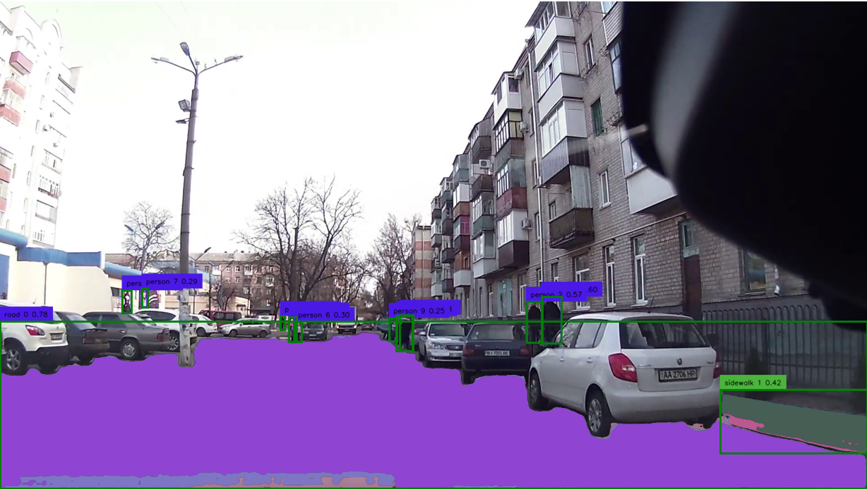
Take a review on SAM:
- can generate pixel level binary mask of the image
- Can be prompted by both point and box, including positive and negative prompt

Slide 13
Take a review on SAM:
Combining with gDINO, then we realize a SOTA semantic segmentation model
- can generate pixel level binary mask of the image
- Can be prompted by both point and box, including positive and negative prompt

Slide 14
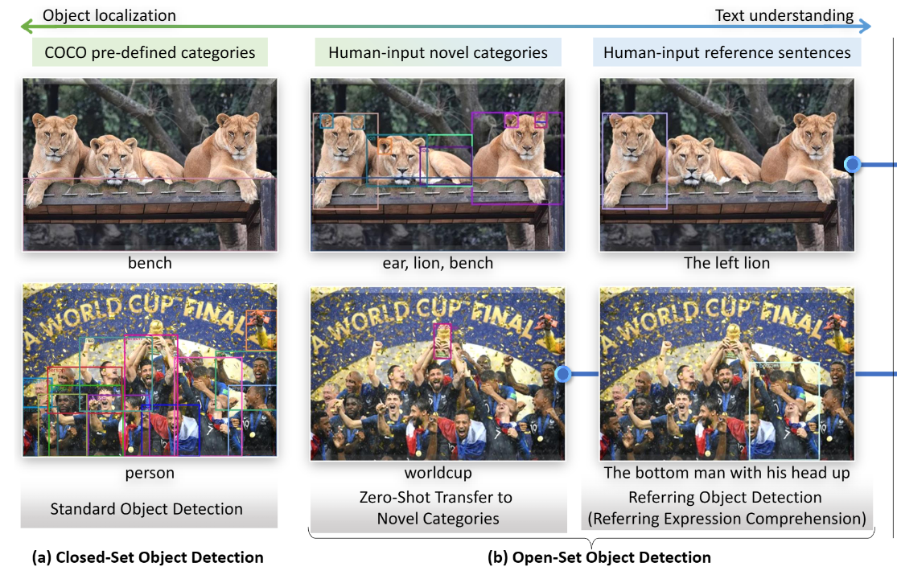
Object detection: Grounding DINO
- [2022SOTA]
- Transformer based knowledge distillation, SOTA zero-shot detection.
- can generate bbox of the detected object using monocular image

Slide 15
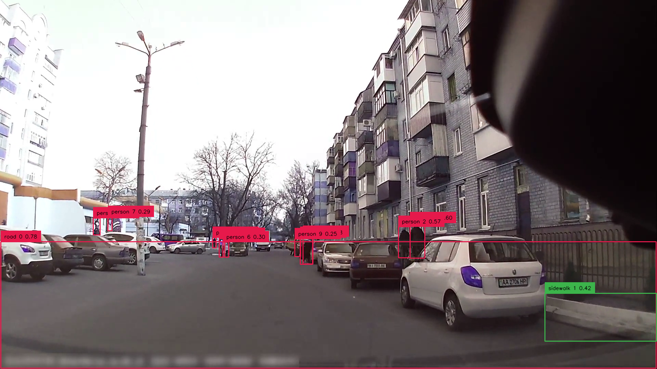
Object detection: Grounding DINO
- Can be prompted based on nature language
- The gDINO can successfully recoginze the road & sidewalk using contrast prompting
- Pedestrian detection is separate, optimizing the accuracy

Slide 16
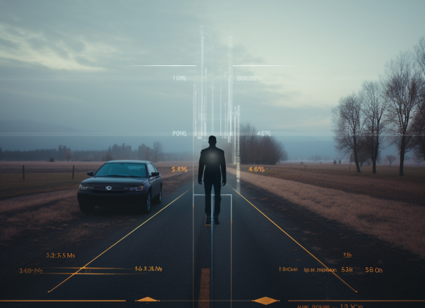
Now, how can we know the distance from pedestrian to us?
In practice: Radar & Lidar of course!
But: we are poor, and we only have monocular video…

Slide 17
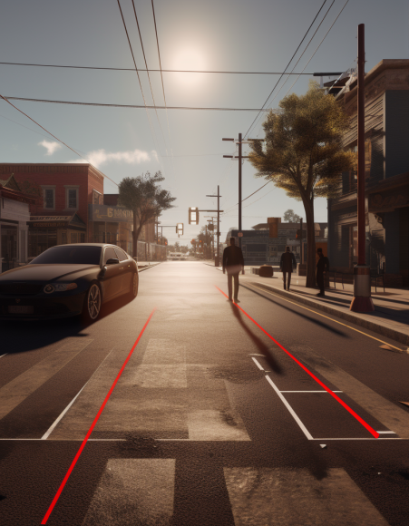
Answer: Monocular depth prediction modal!
They are powerful these days!

Slide 18
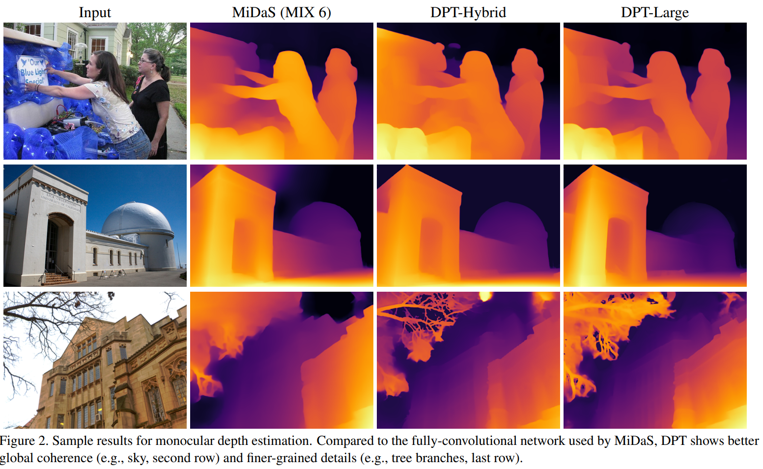
Depth estimation: Dense Prediction Transformer(DPT)
- [2021SOTA]
- Transformer based monocular depth estimation
- can generate image-size NumPy array indicating the depth value of each pixel
- Based on it, we obtained the estimated distance from dashcam to object
Output: [very close, close, medium, far, very far]

Slide 19

LLM: gpt3.5_turbo_16k
- long memory, can analyze the road scene with appropriate prompting
output can be seen here (0728 version):
Summer_Research_2023/Blind_LLM_Guide_Project/Chatbot/

Slide 20
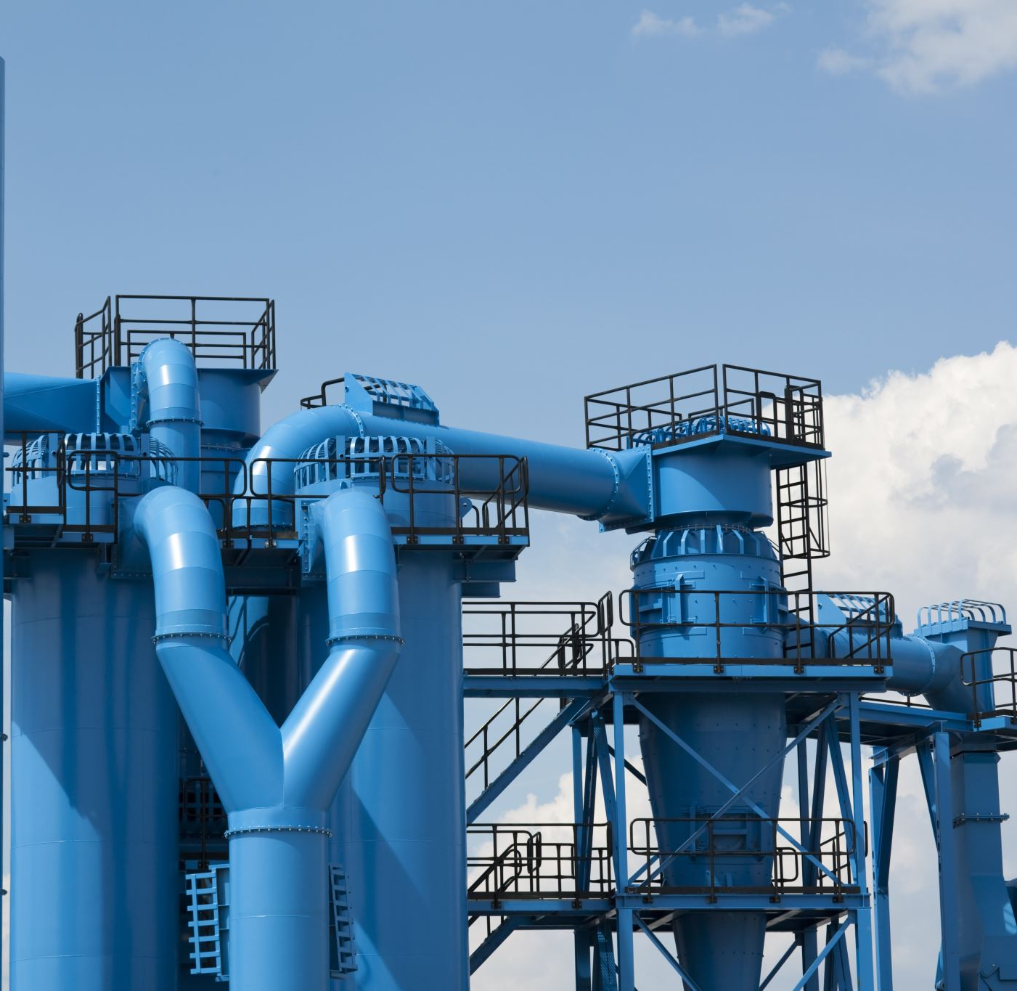
Project Pipeline
So, how do we connect those modal together?

Slide 21
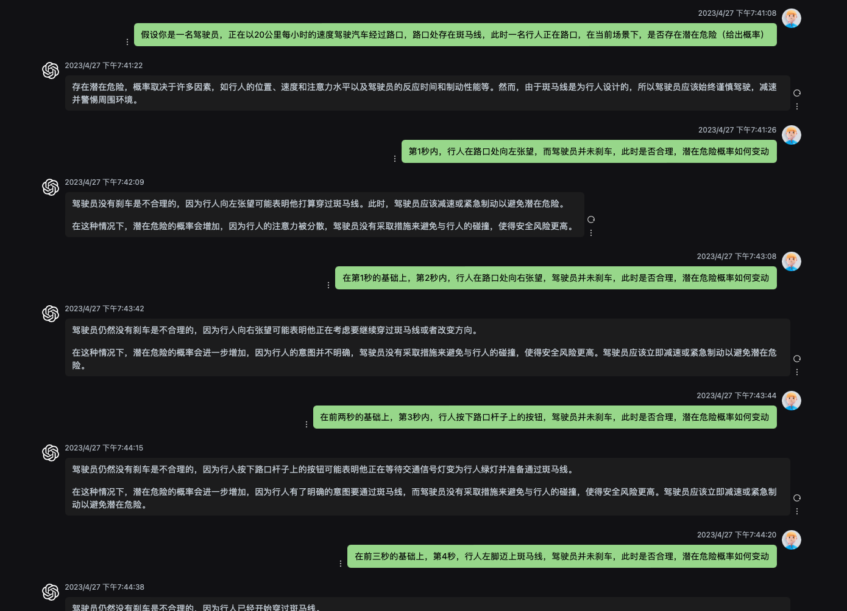
How to use LLM locate potential risk? --- Output format for ZQ & LZY
According to early test on LLM’s capability, it can evaluate the danger level and potential risk within the current driving scenario:
Pic: Zero-shot justification of gpt3.5 turbo

Slide 22
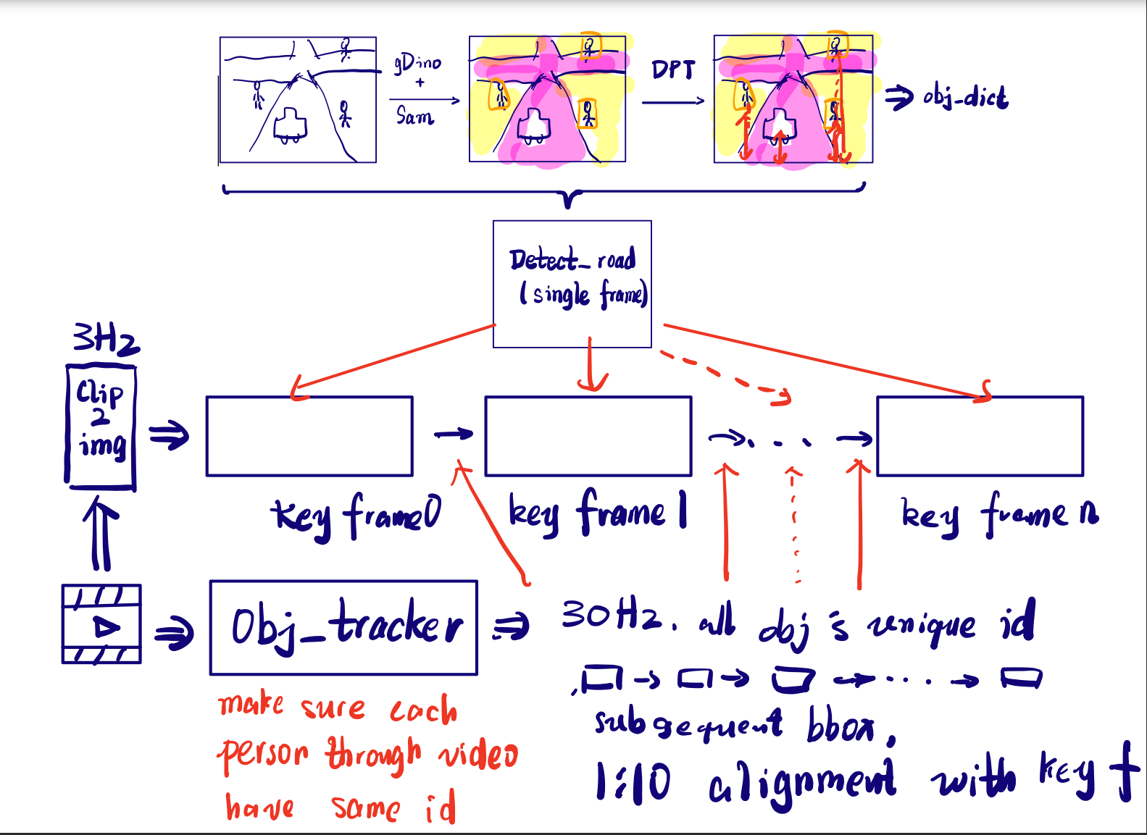
How to use LLM locate potential risk? --- Output format for ZQ & LZY
Our solution: 关键帧+混合帧分析
Furthermore, how can we demonstrate it in: - Vision: ARHUD
Audio: speech reminders
- Similar to 说服组
Notes:
输出要说清楚，怎么交代给

Slide 23
Vision2text
Vision information
Obtain process

Slide 24
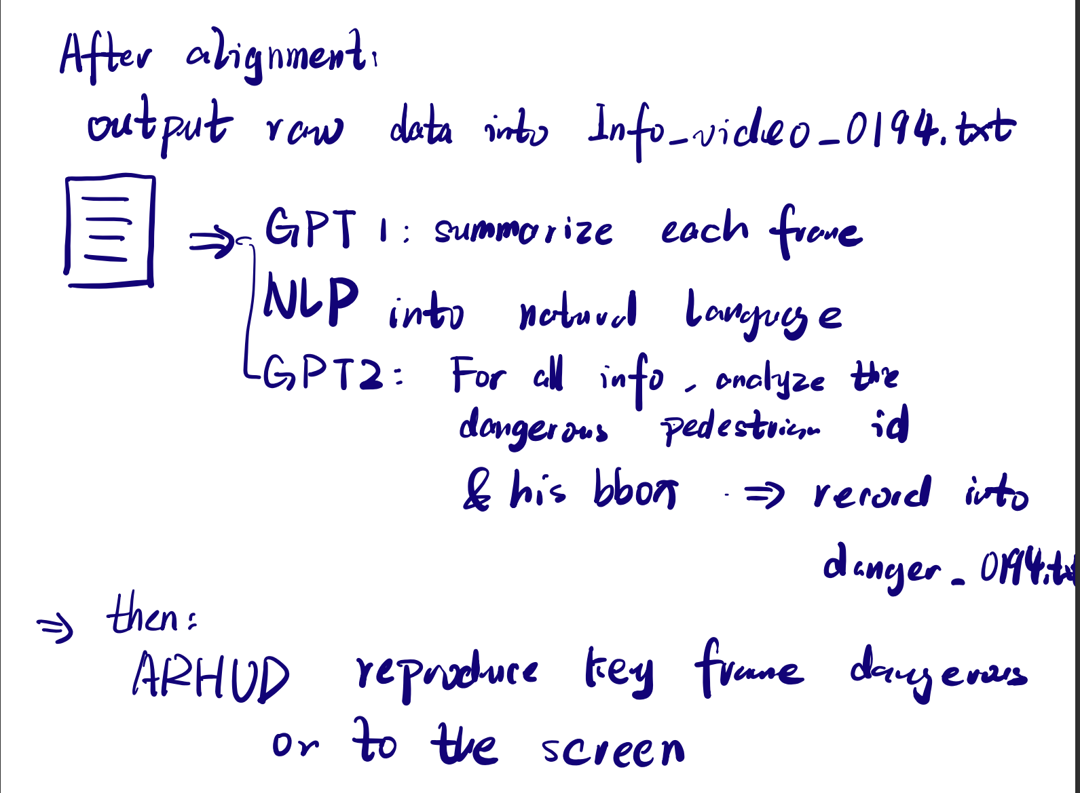
Vision2text
Text generation process

Slide 25
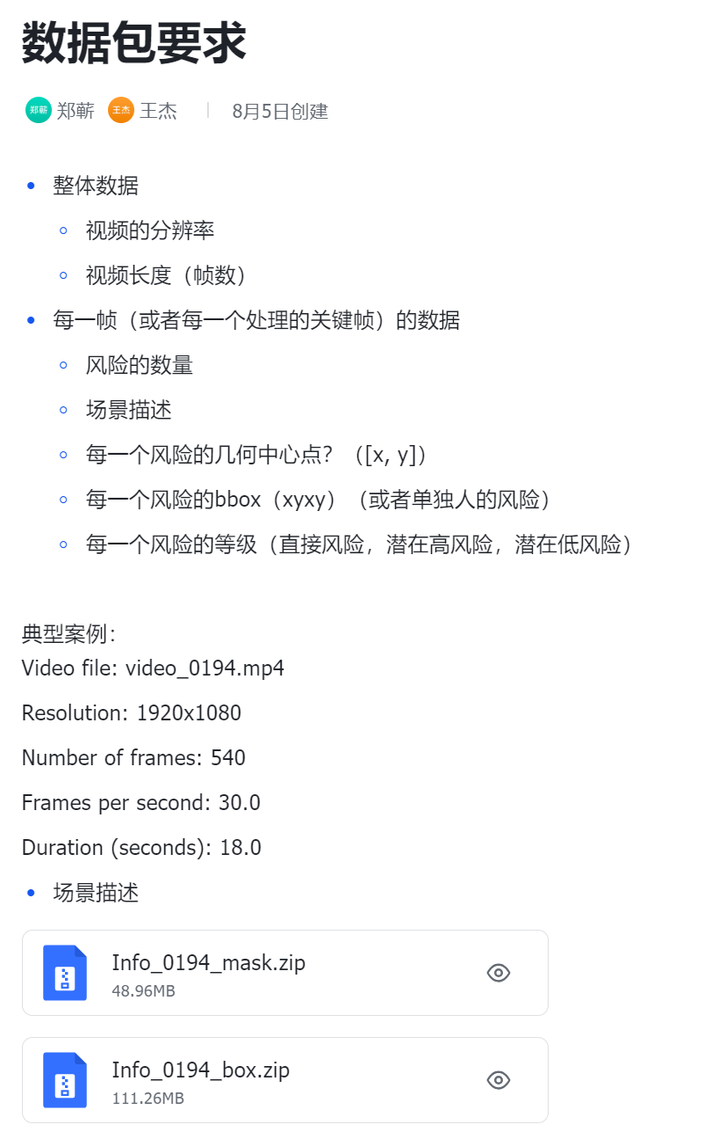
Vision2text
Output format
JSON/dict form for readability [Ongoing part,
working with ZQ now]

Slide 26
Another basic problem: how to test the model?
It occupies a lot of time to do simulation and real-life testing So, we choose video, - monocular - ground truth justification - many pedestrian

Slide 27
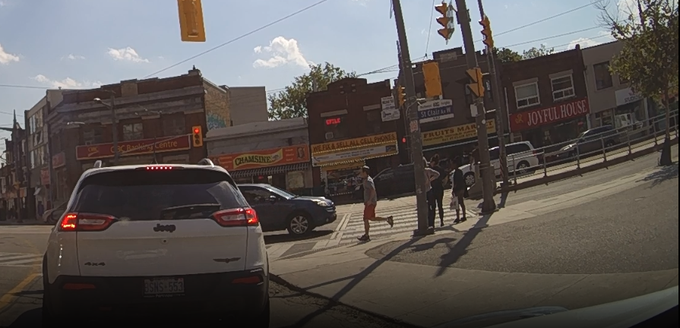
JAAD dataset --- the video dataset for pedestrian intention prediction
What is JAAD? Joint Attention in Autonomous Driving (JAAD) Dataset.
Purpose: Developed to study pedestrian behavior, interactions, and visual cues in the context of autonomous driving.
Content:
Videos: Over 240 high-resolution video clips from different urban locations.
Annotations: Includes detailed annotations for pedestrians, such as age, gender, actions, and signals.
Scene Information: Traffic conditions, weather, lighting, etc.
Attention and Intention: Captures the complex interplay of pedestrian attention and intention.
Applications: Crucial for training models to recognize pedestrian actions, enhance traffic safety, and facilitate the development of advanced driver-assistance systems (ADAS).
Challenges: Addresses the need for fine-grained analysis, such as recognizing subtle cues from pedestrians.
Website: Link to JAAD Dataset
Notes:
后置，不是自己研究的时间顺序，而是论文的逻辑实现技术

Slide 28
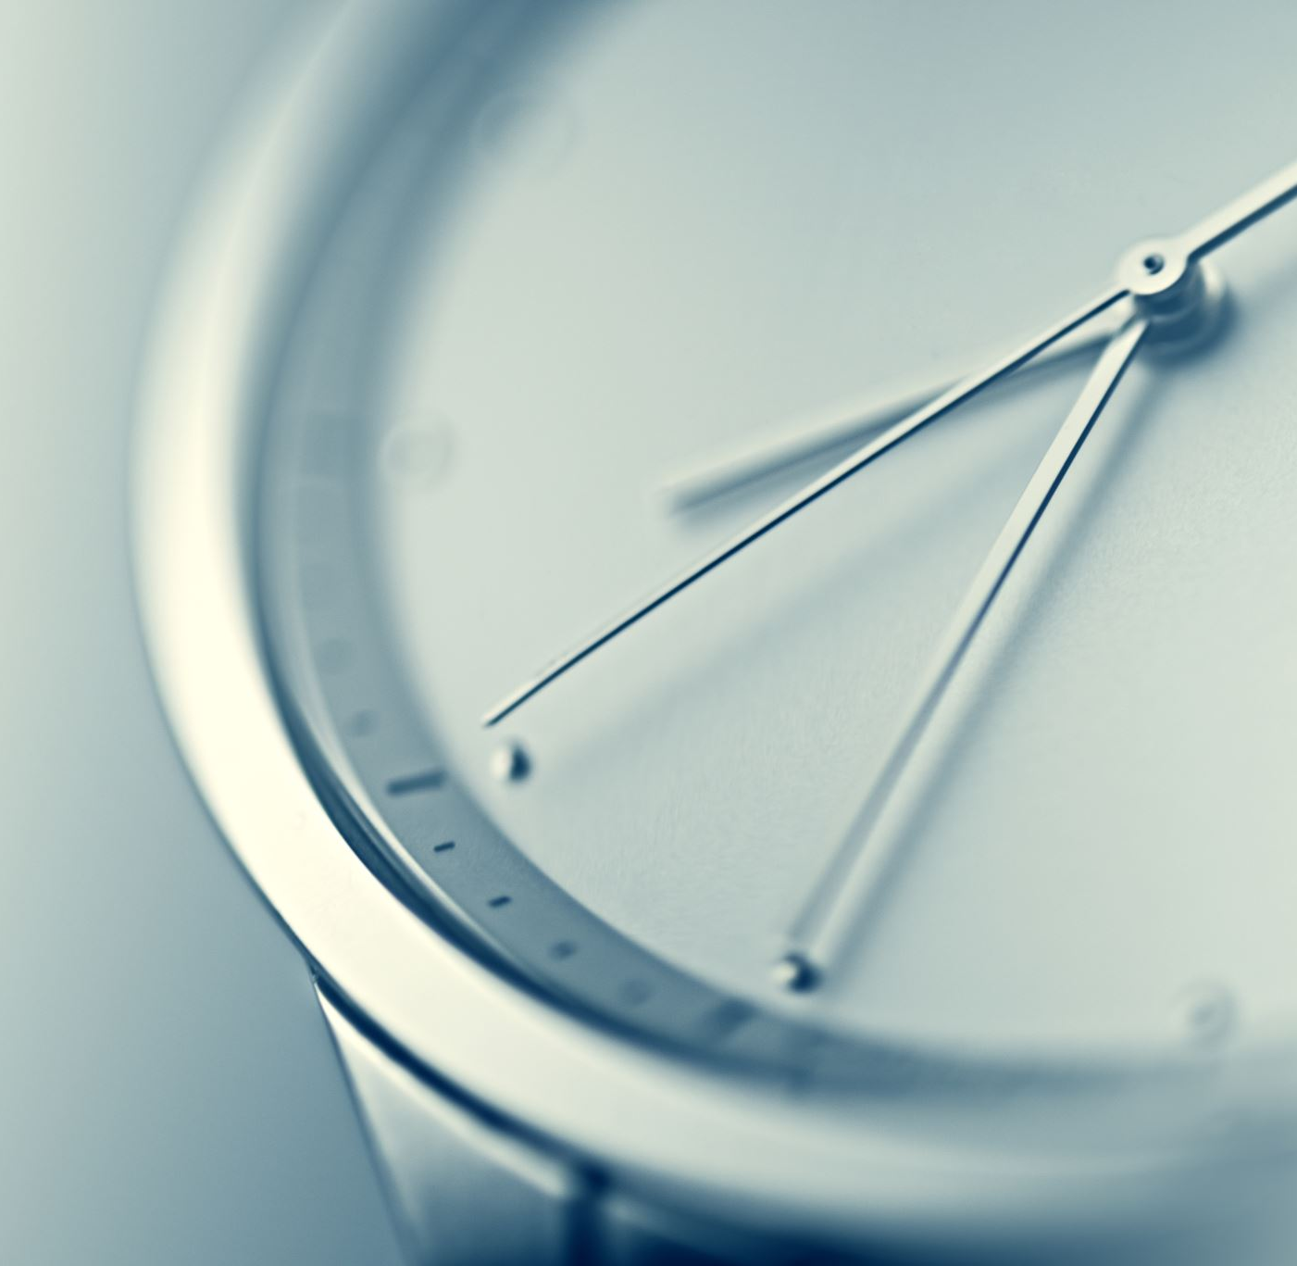
Failure Case 1 Delay
The connected modal is too slow
Real time consideration is important,
But may be not so important
Solution:
Preprocessing for the ARHUD

Slide 29
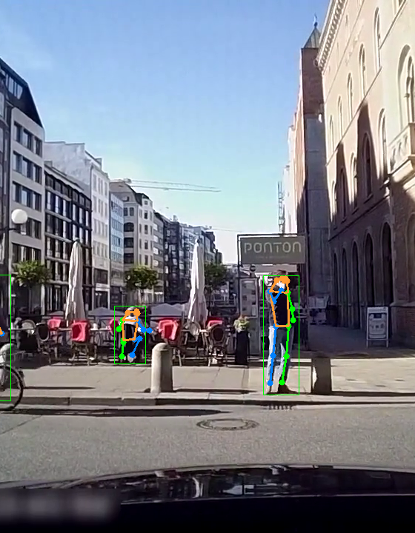
Failure Case 2 Pose Estimation
I want to involve Pose direction for further explanation and description, but It is complex and quite hard to analyze the pose bone (You may still require a neural network to decide which way the man is)

Slide 30
Failure Case 2 Pose Estimation
I want to involve Pose direction for further explanation and description, but It is complex and quite hard to analyze the pose bone (You may still require a neural network to decide which way the man is)

Slide 31
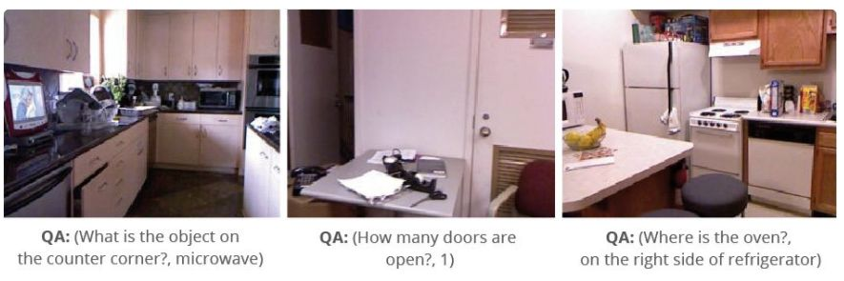
Failure Case 3: VQA(Visual Question Answering)
Given a picture and text question(prompt), the model can give appropriate feed back
Natural approach of considering the vision2text task
however, it don’t work for now, too stupid. There is still not practical modal for common sense justification.

Slide 32
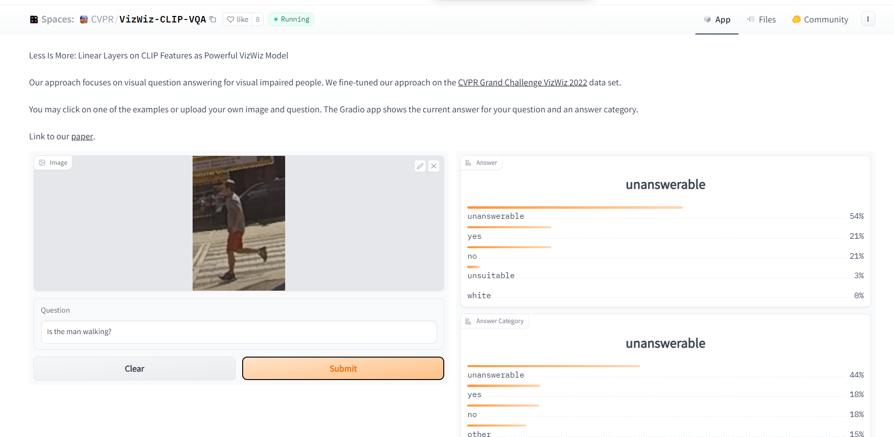
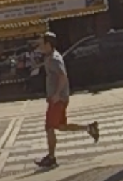
Failure Case 3: VQA(Visual Question Answering)
Can’t recognize color the person is wearing
Can’t distinguish left and right
Can’t distinguish young or old
It is too unstable(50% success rate), so we don’t use it

Slide 33
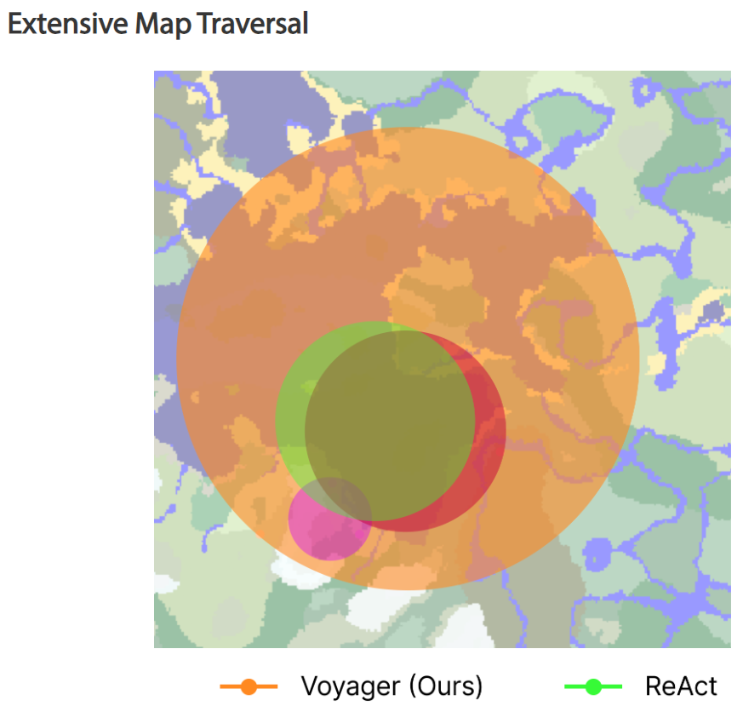
Failure Case 4
Intuition: Let GPT itself decide when to function call other api, obtain more information from the current screen.
Because
the VQA performance can be enhanced in Multiple Object scenario.
This sounds like a more ‘human-like’ behavior
Other Agent: Voyager, AutoGPT…

Slide 34

Failure Case 4
Think too much about the COT
Being a big fan of AI agent like Voyager and code-interpreter, I spent a long time on this huge task. But maybe there exists a gap between personal willing and his ability. Those fancy idea requires a large team and a long time to succeed.

Slide 35

My crazy idea
LLM不应该只是被动的收集信息，他应该主动调用API， 去探测前面的路口状况，让他作为一个Agent去执行分析任务
这样就可以自动化的收集信息，分析数据了
比方说我可以写点segment 的API， 让他可以把一个image的interesting area/ box 切割出来，再图生文，用VQA 或者再调用现有api，输出更多的text info

Slide 36
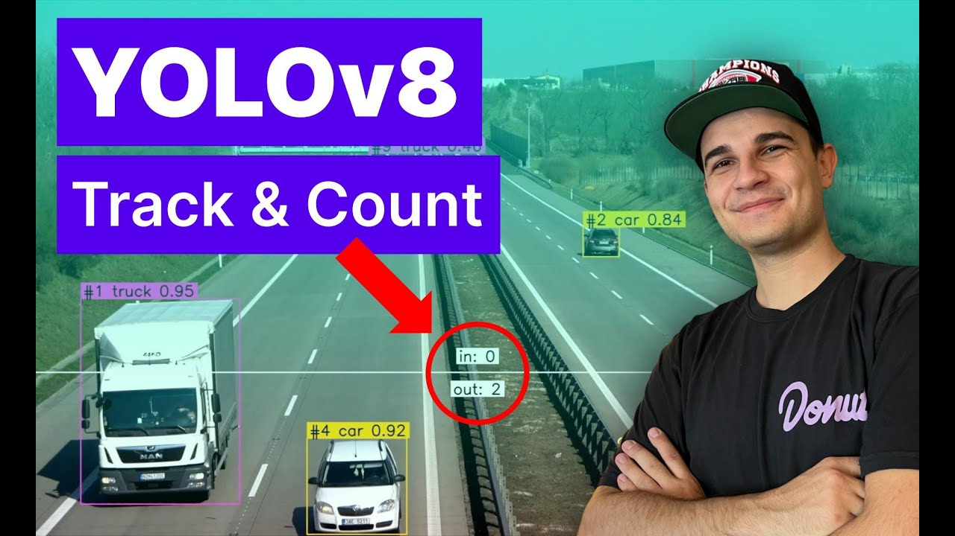
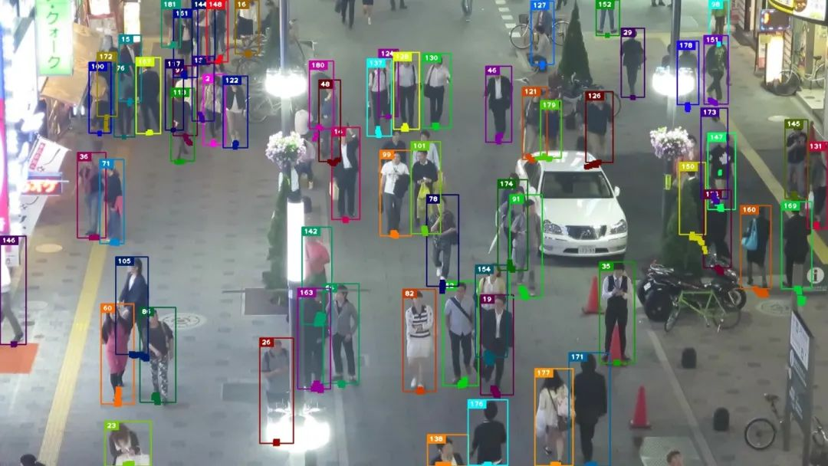
Ongoing: Object Tracking Yolov8+ByteTrack
[2023 SOTA]
Official Support of the classic and powerful real-time CV: You Only Look Once
Fastest with GPU acceleration

Slide 37
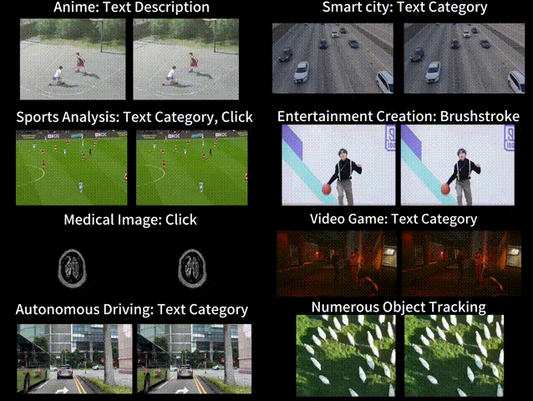
Ongoing: Segment and Track Anything
- [SOTA Mask MOT]
ZJU Work
Based on SAM and AOT(Associating Objects with Transformers, also ZJU work)
tracking and segmenting any objects in videos, either automatically or interactively.
Promptable -> gDINO for text
What a pity: Not use this earlier

Slide 38
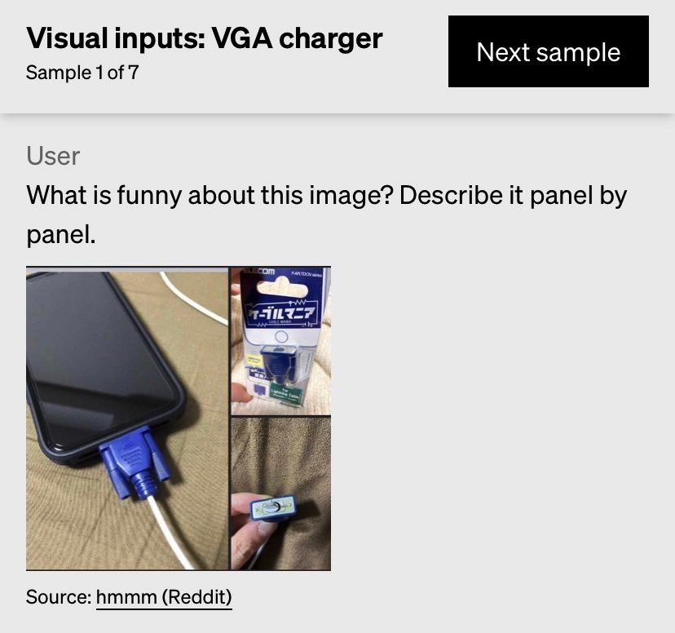
Why is our work more valuable even after visual GPT4 come out?
Vision是内含知识的，这种逻辑推理是显式的（implicit) ，我们的方案可解释性更高，而且算力需求更小（visual 如CLIP等动辄10~20s一张图）
驾驶场景的优先度，场景拆分，深入描述
All need further consideration, visual GPT4 can’t handle all the case as well

Slide 39
Some random thought: those might be useful idea
Be careful of the translation! Once I misunderstand ‘人行道’ to be ‘sideroad’，which greatly lower the performance of gDINO! [prompt engineering]
- in fact: sidewalk / pavement
Treat ChatGPT as your project co-pilot with Custom Instruction, while be careful to its local optimum!
Engaging in engineering requires reading more research papers, as it makes the technical details more concise and valuable. GPT's knowledge base capability is limited, often broad but not insightful enough. If necessary, let GPT help generate keywords, and then we can search on Google Scholar ourselves.
Also, it really helps to watch tutorial sometimes. I should review Andrew Ng's ChatGPT course from time to time.

Slide 40
Some random thought: those might be useful idea
5. The research ability equals engineering ability. A practical shitty draft is better than any dreamy draft. ‘Talk is cheap, show me your code.’ The way I am interested in exploring new insight is coding.
6. Meanwhile, I found it very helpful to write down the messy idea in English when I felt bad.
It is like magic. Maybe it is because of mother tongue shame I suddenly escape from my mental local minimum.
7. Trust and collaborate with teammates on different parts of the project, like HUD design.
8. Seek Expert Opinions: Consider engaging with academics and professionals in the field for insight and potential collaboration (getting push from them)!

Slide 41
The End
That’s all, thank you for listening!

